Slide 1

DJANGO WEB FRAMEWORK
SOFTWARE METRICS MEASUREMENT USING RADON AND PYLINT
Name Roll No
BOREDA ANAND – 16L01A0507
A.ANIL KUMAR – 16L01A0501
SYED MOIZUDDIN – 16L01A0546
M.YASHWANTH – 16L01A0525
R. Vinod Kumar
B. Tech, M. Tech
Internal Guide

Slide 2


INTRODUCTION
Django framework is a compact Python framework intended for quick development
we will find out software metrics for Django using Radon that provides cyclomatic complexity raw metrics that consists SLOC, comment lines, number blank lines, Maintainability Index and Halstead metrics, also use Pylint
Pylint is a source code analyzer that finds for errors in programming, assists to use a coding standard strictly.

Slide 3
FEASIBILITY

Slide 4
FEASIBILITY
Business proposal is put forth with a very general plan for the project and some cost estimates
Requirements :
Economical feasibility
Technical feasibility
Social feasibility

Slide 5
FEASIBILITY
Economic study : carried out to check the economic impact that the system will have on the organization
Technical study : carried out to check the technical feasibility, that is, the technical requirements of the system
Social Feasibility: study is to check the level of acceptance of the system by the user

Slide 6
ANALYSIS

Slide 7
EXISTING SYSTEM
Flask framework is a Python micro-framework with a moderate approach and powerful by itself. Flask perfect for stand-alone applications and rapid prototyping.
Pyramid known as Pylons is a framework that gives reproducibility with NoSQL integration. Pyramid best for APIs, prototyping, and extensive web apps, like content management systems development.
Tornado is an event-based, non-blocking Python web server and web application framework serve high-traffic volume. The Bottle is a light and simple microframework.

Slide 8
PROPOSED SYSTEM
Django is a framework for web development using python and created for the quick development of database driven sites
It focuses inefficiency, giving developer to do almost all tasks with as little coding effort as possible.

Slide 9
HARDWARE REQUIREMENTS
System : Pentium IV 2.4 GHz.
Hard Disk : 40 GB.
Floppy Drive : 1.44 Mb.
Monitor : 14’ Colour Monitor.
Mouse : Optical Mouse.
Ram : 512 Mb.

Slide 10
SOFTWARE REQUIREMENTS
Operating system : Windows 7 Ultimate.
Coding Language : Python.
Front-End : Python.
Designing : Html, CSS, JavaScript.
Data Base : MySQL.

Slide 11
DESIGN

Slide 12
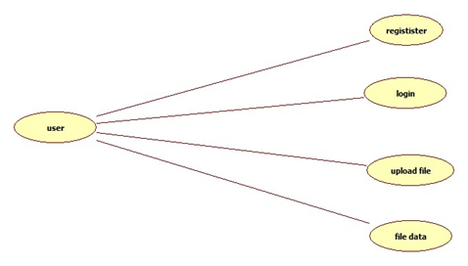
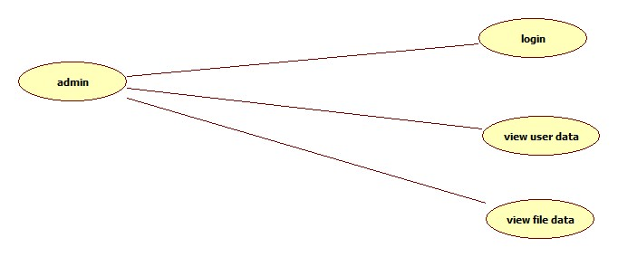
USE CASE DIAGRAMS

Slide 13
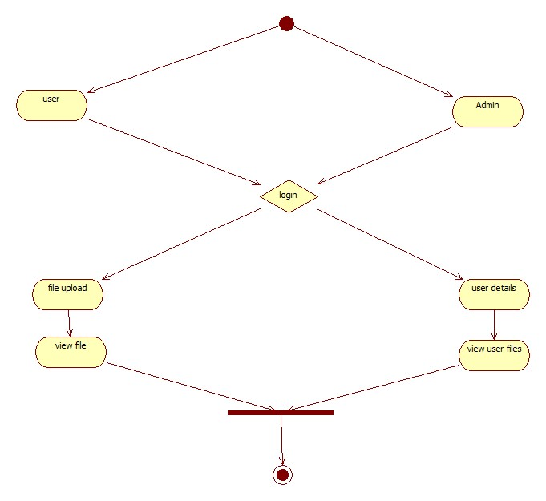
ACTIVITY DIAGRAM

Slide 14
IMPLEMENTATION

Slide 15
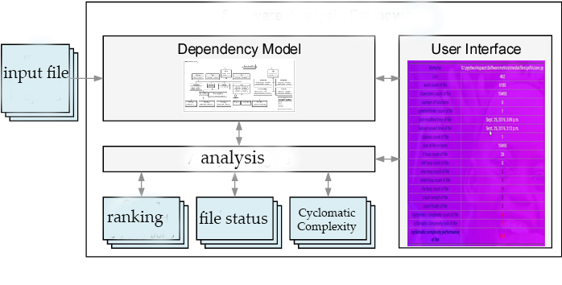
SYSTEM ARCHITECTURE

Slide 16


THANK YOU

